Slide 1
R Basics https://cran.r-project.org/

Slide 2
Compiled C vs Interpreted R
C requires a complete program to run
  Program is translated into machine code
  Can then be executed repeatedly
R can run interactively
  Statements converted to machine instructions as they are encountered
  This is much more flexible, but also slower

Slide 3
About R
R is a free and powerful statistical software for analyzing and visualizing data.
R can be used to compute a large variety of classical statistic tests such as t-test, chi-square test, ANOVA and correlation analysis.
It’s also possible to use R for performing classification analysis and clustering.
Many types of graphs can be drawn using R, including: box plot, histogram, density curve, scatter plot, line plot, bar plot.

Slide 4
FEATURES OF R
R is a well-developed, simple and effective programming language which includes conditionals, loops, user defined recursive functions and input and output facilities.
R has an effective data handling and storage facility,
R provides a suite of operators for calculations on arrays, lists, vectors and matrices.
R provides a large, coherent and integrated collection of tools for data analysis.
R provides graphical facilities for data analysis and display either directly at the computer or printing at the papers.

Slide 5
Why learning R?
R is open source, so it’s free.
R is cross-plateform compatible, so it can be installed on Windows, MAC OSX and Linux
R provides a wide variety of statistical techniques and graphical capabilities.
R provides the possibility to make a reproducible research by embedding script and results in a single file.

Slide 6
R has a vast community both in academia and in business
R is highly extensible and it has thousands of well-documented extensions (named R packages) for a very broad range of applications in the financial sector, health care,…
It’s easy to create R packages for solving particular problems

Slide 7
R programming basics
R can be used as a calculator. We can perform:
Basic arithmetic operations
The basic arithmetic operators are:
+ (addition)
- (subtraction)
* (multiplication)
/ (division)
and ^ (exponentiation)
%% (Modulus)

Slide 8
Basic arithmetic functions
Logarithms and Exponentials:
log2(x) # logarithms base 2 of x
log10(x) # logaritms base 10 of x
exp(x) # Exponential of x
Trigonometric functions:
cos(x) # Cosine of x
sin(x) # Sine of x
tan(x) #Tangent of x
acos(x) # arc-cosine of x
asin(x) # arc-sine of x
atan(x) #arc-tangent of x

Slide 9
Other mathematical functions
abs(x) # absolute value of x
sqrt(x) # square root of x

Slide 10
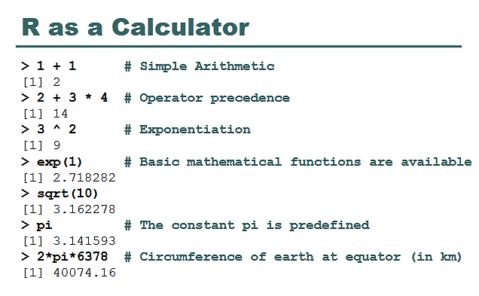

Slide 11
Basics
>sqrt(2)
[1] 1.414214
> log(2)
[1] 0.6931472
>seq(1,5, by=.5)
[1] 1.0 1.5 2.0 2.5 3.0 3.5 4.0 4.5 5.0

Slide 12

Relational Operators defines relation between the two operands provided to them. Following are the six relational operations R programming language supports.
Operator | Description | Usage
< | Is first operand less than second operand | a < b
> | Is first operand greater than second operand | a > b
== | Is first operand equal to second operand | a == b
<= | Is first operand less than or equal to second operand | a <= b
>= | Is first operand greater than or equal to second operand | a > = b
!= | Is first operand not equal to second operand

Slide 13
The output is boolean (TRUE or FALSE) for all of the Relational Operators in R programming language.
a <- 7.5
b <- 2
print ( a<b ) # less than
print ( a>b ) # greater than
print ( a==b ) # equal to
print ( a<=b ) # less than or equal to
print ( a>=b ) # greater than or equal to
print ( a!=b ) # not equal to

Slide 14
R Logical Operators
Logical Operators in R programming language work only for the basic data types logical, numeric and complex and vectors of these basic data types.
Operator | Description | Usage
& | Element wise logical AND operation. | a & b
| | Element wise logical OR operation. | a | b
! | Element wise logical NOT operation. | !a
&& | Operand wise logical AND operation. | a && b
|| | Operand wise logical OR operation. | a || b

Slide 15
Example
a <- 0 # logical FALSE
b <- 2 # logical TRUE
print ( a & b ) # logical AND element wise
print ( a | b ) # logical OR element wise
print ( !a ) # logical NOT element wise
print ( a && b ) # logical AND consolidated for all elements
print ( a || b ) # logical OR consolidated for all elements

Slide 16
R Assignment Operators
Assignment Operators are those that help in assigning a value to the variable.
Operator | Description | Usage
= | Assigns right side value to left side operand | a = 3
<- | Assigns right side value to left side operand | a <- 5
-> | Assigns left side value to right side operand | 4 -> a
<<- | Assigns right side value to left side operand | a <<- 3.4
->> | Assigns left side value to right side operand | c(1,2) ->> a

Slide 17
Example
a = 2
print ( a )
a <- TRUE
print ( a )
454 -> a
print ( a )
a <<- 2.9
print ( a )
9 -> a
print ( a )

Slide 18
Assigning values to variables:
A variable can be used to store a value.
To assign the value to variable we can use <- or = .
Example
# Price of a lemon = 2 euros
lemon_price <- 2
# or use this
lemon_price = 2
Note that, R is case-sensitive. This means that lemon_price is different from Lemon_Price.

Slide 19
Accessing the variables
There are two methods to access the variable
type its name
Using Function print()
Example:
lemon_price
or
print(lemon_price)

Slide 20
R saves the object name (also known as a variable) in memory. It’s possible to make some operations with it.
Example
5*lemon_price
We can change the value of the variable using <-

Slide 21
Perform all the arithmetic operations.
Calculate the area of circle

Slide 22
Data Types
R has 6 basic data types.
character
numeric (real or decimal)
integer
logical
Complex
character: "a", "swc"
numeric: 2, 15.5
integer: 2L (the L tells R to store this as an integer)
logical: TRUE, FALSE
complex: 1+4i (complex numbers with real and imaginary parts)

Slide 23
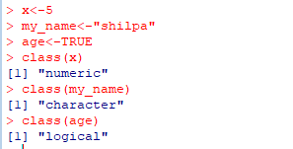
R Data Types
Basic data types are numeric, character and logical.
Example
my_age <- 28 //Number Object
my_name <- "Nicolas” //Character
is_datascientist <- TRUE //Logical object
class() is use to see what type a variable is

Slide 24
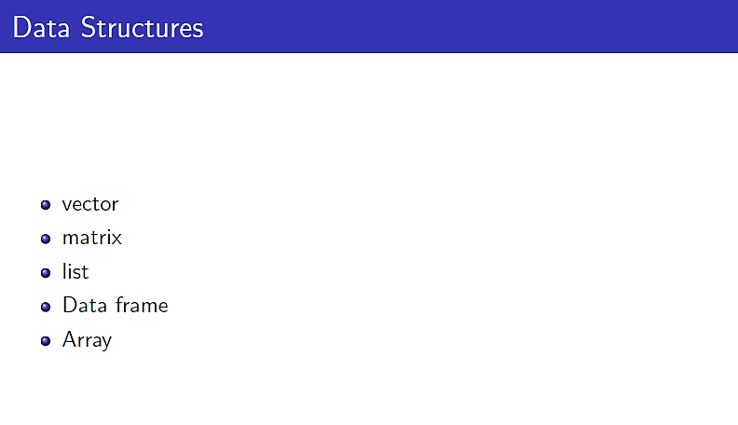

Slide 25
Vectors are the most basic R data objects and there are six types of atomic vectors. They are logical, integer, double, complex, character and raw.
Vector Creation
Single Element Vector
Even when you write just one value in R, it becomes a vector of length 1 and belongs to one of the above vector types.
Using print() we can print Single element vector such as:
print(2), print(“ HELLO“), print(6.4), print(TRUE)

Slide 26
Multiple Elements Vector
Using colon operator with numeric data
V<-5:10
Or
v<-10.6:50.6
Or
V<-5.6:100.4
Using sequence (Seq.) operator
seq(1,10)
or
Seq(1,10, by=2)

Slide 27
Vector
A vector is a sequence of data elements of the same basic type. Members in a vector are officially called components. Most commonly of modes are character, logical, integer or numeric.
Here is a vector containing three numeric values 2, 3 and 5.
> c(2, 3, 5)
[1] 2 3 5
And here is a vector of logical values.
> c(TRUE, FALSE, TRUE, FALSE, FALSE)
[1] TRUE FALSE TRUE FALSE FALSE
A vector can contain character strings.
> c("aa", "bb", "cc", "dd", "ee")
[1] "aa" "bb" "cc" "dd" "ee"
The number of members in a vector is given by the length function.
> length(c("aa", "bb", "cc", "dd", "ee"))
[1] 5

Slide 28
Vector Creation
Single Element Vector: when you write just one value in R, it becomes a vector of length 1.
Multiple Elements Vector
  Using colon operator with numeric data
  Using sequence (Seq.) operator
  Using the c() function: The non-character values are coerced to character type if one of the elements is a character.
Notes:
Coerced = forcefully

Slide 29
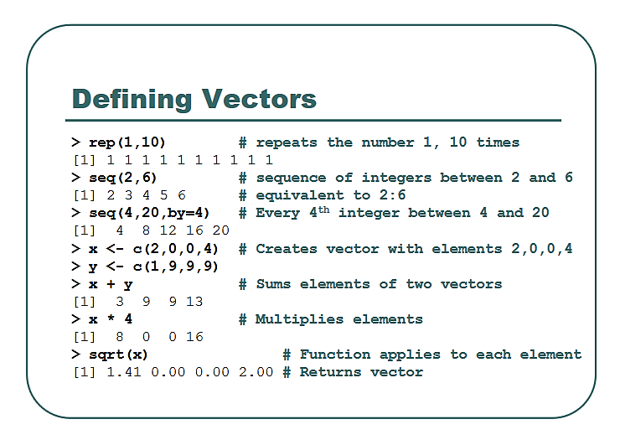

Slide 30
R code
LETTERS[seq(1,10)]
> max(v3);min(v3)
[1] 16
[1] 6
> length(v3)
[1] 6
> mean(v3)
[1] 11
> sd(v3)
[1] 3.741657
>range(v3)

Slide 31
If we want to find where the minimum or maximum is located, i.e. the index instead of the actual value, then we can use which.min() and which.max() functions.
Note that these functions will return the index of the first minimum or maximum in case multiple of them exists.
> x
[1] 5 8 3 9 2 7 4 6 10
> # find index of the minimum
> which.min(x)
[1] 5
> # find index of the minimum
> which.max(x)
[1] 9
> # alternate way to find the minimum
> x[which.min(x)]
[1] 2

Slide 32
# Creating a sequence from 5 to 13.
v <- 5:13
print(v)
# Creating a sequence from 6.6 to 12.6.
v <- 6.6:12.6
print(v)
# If the final element specified does not belong to the sequence then it is discarded.
v <- 3.8:11.4
print(v)
Notes:
Practice

Slide 33
Solution
[1] 5 6 7 8 9 10 11 12 13
[1] 6.6 7.6 8.6 9.6 10.6 11.6 12.6
[1] 3.8 4.8 5.8 6.8 7.8 8.8 9.8 10.8

Slide 34
Accessing Vector Elements
Elements of a Vector are accessed using indexing.
The [ ] brackets are used for indexing. Indexing starts with position 1.
Giving a negative value in the index drops that element from result.
TRUE, FALSE or 1and 0 can also be used for indexing.

Slide 35
# Accessing vector elements using position.
t <- c("Sun","Mon","Tue","Wed","Thurs","Fri","Sat")
u <- t[c(2,3,6)]
print(u)
# Accessing vector elements using logical indexing.
v <- t[c(TRUE,FALSE,FALSE,FALSE,FALSE,TRUE,FALSE)]
print(v)
# Accessing vector elements using negative indexing.
x <- t[c(-2,-5)]
print(x)
# Accessing vector elements using 0/1 indexing.
y <- t[c(0,0,0,0,0,0,1)]
print(y)

Slide 36
Solution
[1] "Mon" "Tue" "Fri"
[1] "Sun" "Fri"
[1] "Sun" "Tue" "Wed" "Fri" "Sat"
[1] "Sun"

Slide 37
Vector Manipulation
Vector arithmetic
  Two vectors of same length can be added, subtracted, multiplied or divided giving the result as a vector output.
Vector element recycling
  If we apply arithmetic operations to two vectors of unequal length, then the elements of the shorter vector are recycled to complete the operations.
Vector Element Sorting
  Elements in a vector can be sorted using the sort() function.

Slide 38
Vector arithmetic
> v1 = c(6,5,4,3,2,1)
> v1
>[1] 6 5 4 3 2 1
>v2 = c(10,9,8,7,6,5)
> v3 = v1 + v2
> v3
[1] 16 14 12 10 8 6

Slide 39
Vector element recycling
v1 <- c(3,8,4,5,0,11)
v2 <- c(4,11)
# V2 becomes c(4,11,4,11,4,11)
add.result <- v1+v2
print(add.result)
sub.result <- v1-v2
print(sub.result)

Slide 40
Vector Element Sorting
v <- c(3,8,4,5,0,11, -9, 304)
# Sort the elements of the vector.
sort.result <- sort(v)
# Sort the elements in the reverse order.
revsort.result <- sort(v, decreasing = TRUE)
# Sorting character vectors.
v <- c("Red","Blue","yellow","violet")
sort.result <- sort(v)
# Sorting character vectors in reverse order.
revsort.result <- sort(v, decreasing = TRUE)

Slide 41
ORDER()
Sometimes we would want the index of the sorted vector instead of the values. In such case we can use the function order().
> x
[1] 7 1 8 3 2 6 5 2 2 4
> order(x)
[1] 2 5 8 9 4 10 7 6 1 3
> order(x, decreasing=TRUE)
[1] 3 1 6 7 10 4 5 8 9 2
> x[order(x)] # this will also sort x
[1] 1 2 2 2 3 4 5 6 7 82

Slide 42
How to modify a vector in R?
x<-c(-3,-2,-1,0,1,2,3)
> x
[1] -3 -2 -1 0 1 2
> x[2] <- 0; x # modify 2nd element
[1] -3 0 -1 0 1 2
> x[x<0] <- 5; x # modify elements less than 0
[1] 5 0 5 0 1 2
> x <- x[1:4]; x # truncate x to first 4 elements
[1] 5 0 5 0

Slide 43
How to delete a Vector?
We can delete a vector by simply assigning a NULL to it.
> x
[1] -3 -2 -1 0 1 2
> x <- NULL
> x
NULL
> x[4]
NULL

Slide 44
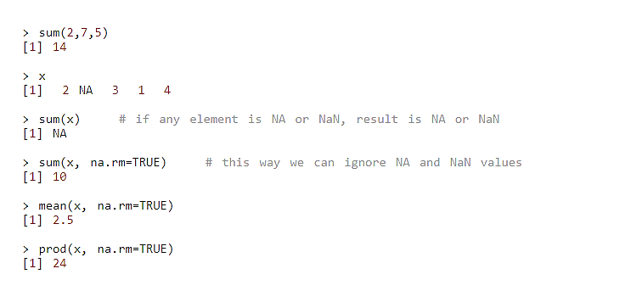

Find Sum, Mean and Product of Vector in R Programming

Slide 45
Matrix
Matrix is a two dimensional data structure in R programming
Matrix is similar to vectors but additionally contains the dimension attribute.
Dimension can be checked directly with the dim() function
Matrix can be created using the matrix() function.
Dimension of the matrix can be defined by passing appropriate value for arguments nrow and ncol.
Providing value for both dimension is not necessary. If one of the dimension is provided, the other is inferred from length of the data.

Slide 46
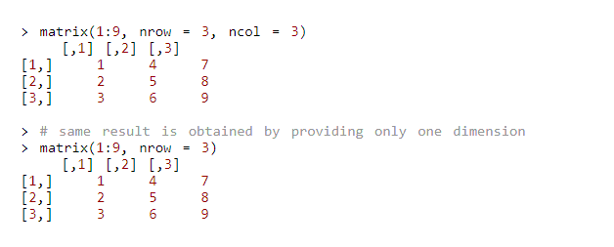
Example Matrix

Slide 47
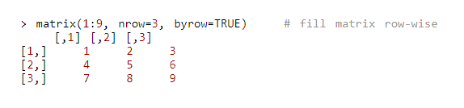
Matrix
We can see that the matrix is filled column-wise. This can be reversed to row-wise filling by passing TRUE to the argument byrow

Slide 48
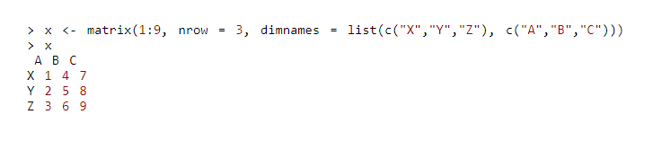
Matrix
It is possible to name the rows and columns of matrix during creation by passing a 2 element list to the argument dimnames.

Slide 49
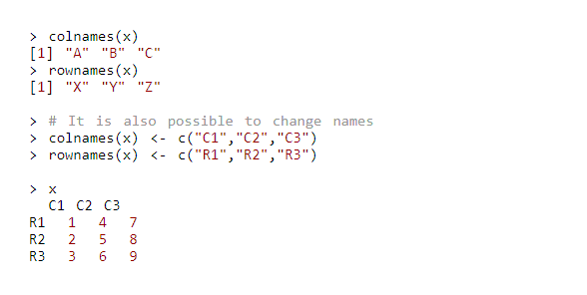
Matrix
These names can be accessed or changed with two helpful functions colnames() and rownames().

Slide 50
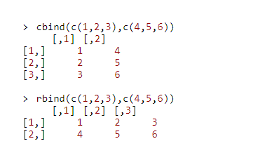
Another way of Matrix creation
Another way of creating a matrix is by using functions cbind() and rbind() as in column bind and row bind.

Slide 51
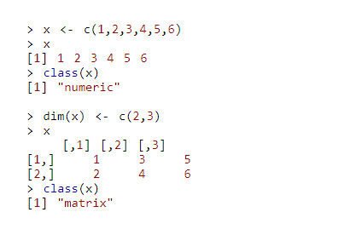
Another way of Matrix creation
Finally, you can also create a matrix from a vector by setting its dimension using dim().

Slide 52
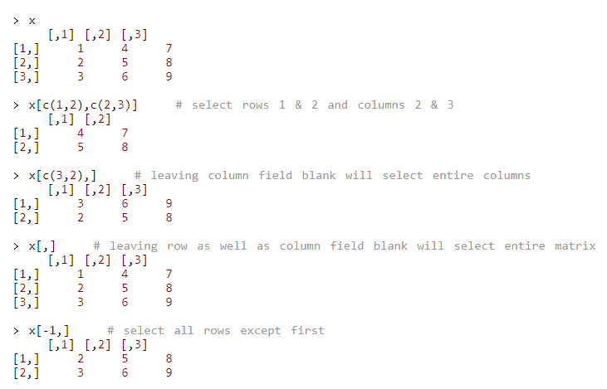
How to access Elements of a matrix?
Using integer vector as index

Slide 53
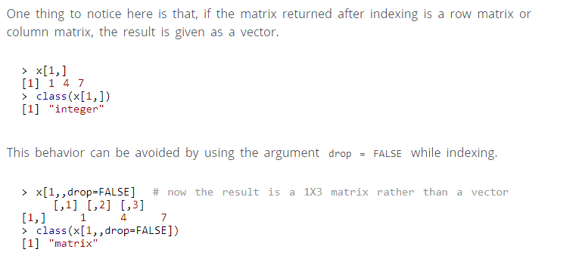

Slide 54
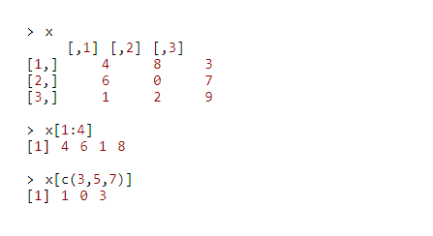
Accessing Matrix

Slide 55
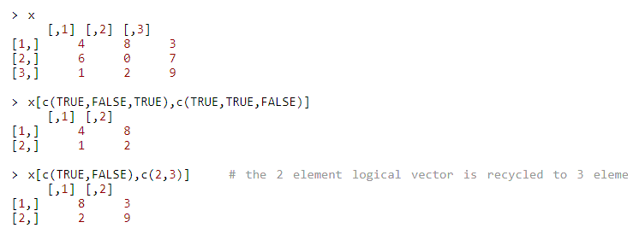
Using logical vector as index
Two logical vectors can be used to index a matrix. In such situation, rows and columns where the value is TRUE is returned. These indexing vectors are recycled if necessary and can be mixed with integer vectors.

Slide 56
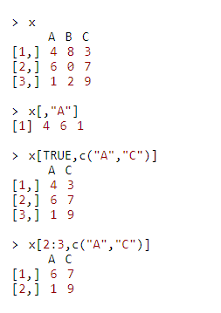
Using character vector as index

Slide 57
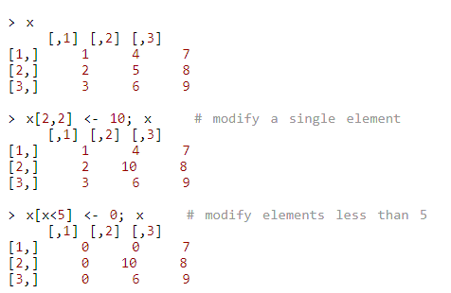
How to modify a matrix in R?

Slide 58
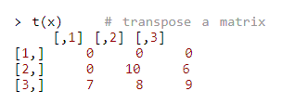
Transpose of Matrix
A common operation with matrix is to transpose it. This can be done with the function t().

Slide 59
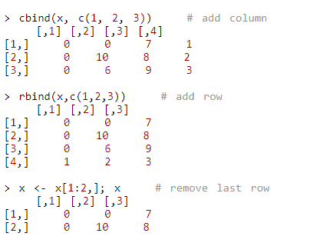
add row or column
We can add row or column using rbind() and cbind() function respectively. Similarly, it can be removed through reassignment.

Slide 60
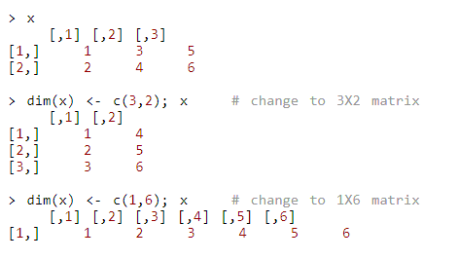
Modifying a dimension
Dimension of matrix can be modified as well, using the dim() function.

Slide 61
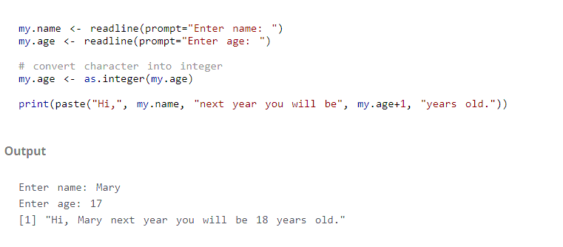
R Program to Take Input From User

Slide 62
Examples
Check out these related examples:
  Find Sum, Mean and Product of Vector in R Programming
  R Program to Add Two Vectors
  R Program to Find Minimum and Maximum
  R Program to Take Input From User
  Find the sum of two matrices, and find the largest element among the two matrices.

Slide 63
  Find Sum, Mean and Product of Vector in R Programming
  R Program to Add Two Vectors
  R Program to Find Minimum and Maximum
  Take the string elements and print the list is sorted order
  Take the numeric elements list and check 5th index element is even and more than 15.

